Slide 1
Train-the-Trainer
for the TIME4CS Training Program

Slide 2
Train-the-Trainer
Training Program
Training Module TTT 1.1: Stakeholders and Audiences
  Training Module TTT 1.1.1: Stakeholder analysis and audience mapping
  Training Module TTT 1.1.2: Interactive session: Stakeholder analysis
Training Module TTT 1.2: Training Design
  Training Module TTT 1.2.1: Training design using the Logic Model framework
  Training Module TTT 1.2.2: Interactive session: Design your own training
Training Module TTT 1.3: Challenges & Solutions to Implementing and Embedding Training
  Training Module TTT 1.3.1: SWOT (Strengths, Weaknesses, Opportunities, and Threats) analysis of the implementation and embedding of training programs
  Training Module TTT 1.1.2: Interactive session: Identify challenges & solutions

Slide 3
Train-the-Trainer
Learning objectives
conduct a stakeholder analysis for training design purposes
understand the available TIME4CS training modules that can be used for training and how to design their training based on those modules
plan and design customised training sessions for their institutions based on the TIME4CS training modules, taking into account their stakeholders, learning styles and listening, and audiences’ needs/demands/experiences
customise learning objectives, content, exercises, and assessment
identify and mitigate challenges to implementing their training

Slide 4
Stakeholders & Audiences
Training module TTT 1.1

Slide 5
Stakeholder analysis and audiences mapping
Training module TTT 1.1.1

Slide 6
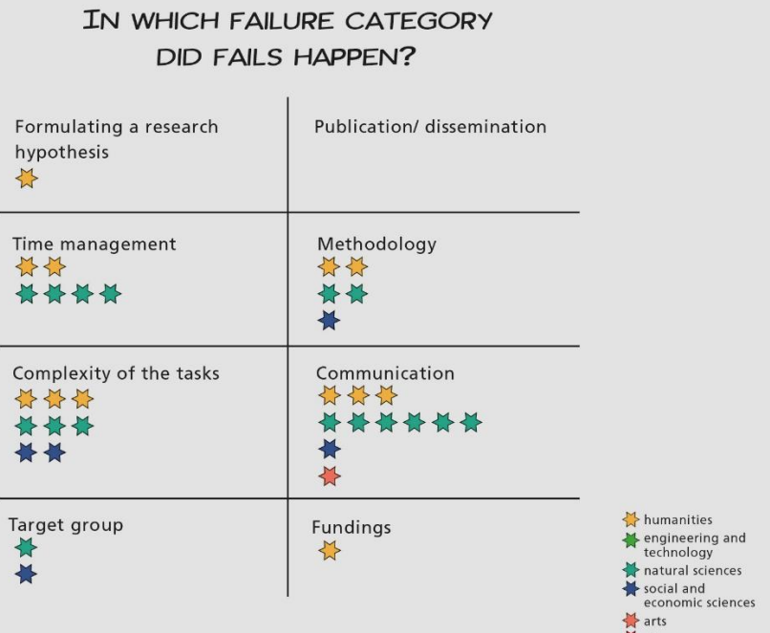
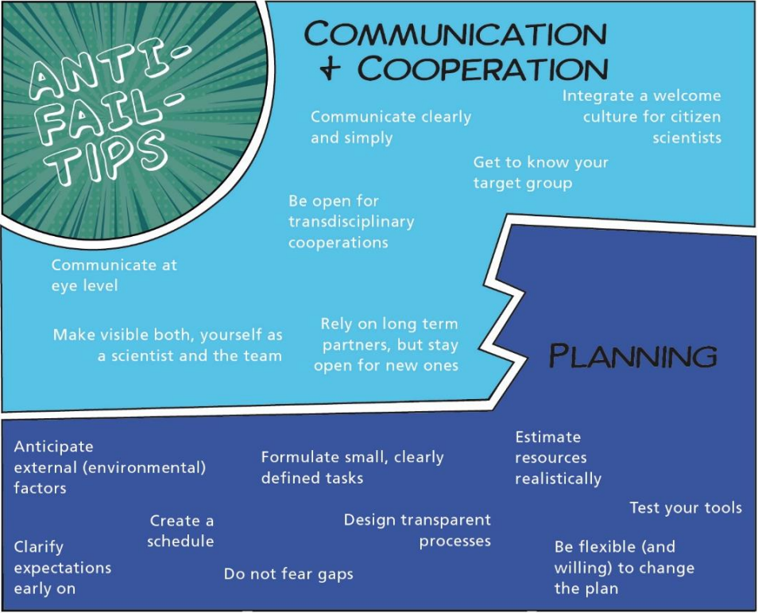
Why do some citizen science projects fail?
Because they don’t know their target group / audience which is also important for training providers
Westreicher et al., 2021

Slide 7


Ladder of Participation for participants
AND researchers and other staff!
Be aware that everyone starts with being ‘Unaware’
Training can get people up the ladder
Personal connections and
personal action are
important to get
people further
up the ladder
Ensure hands-on
activities and
interactive
sessions
in your
training
Co-creation & leadership
Personal action
Ambassador
Personal connection
Active
Training / awareness raising / education
Engaged
Aware
Unaware

Slide 8
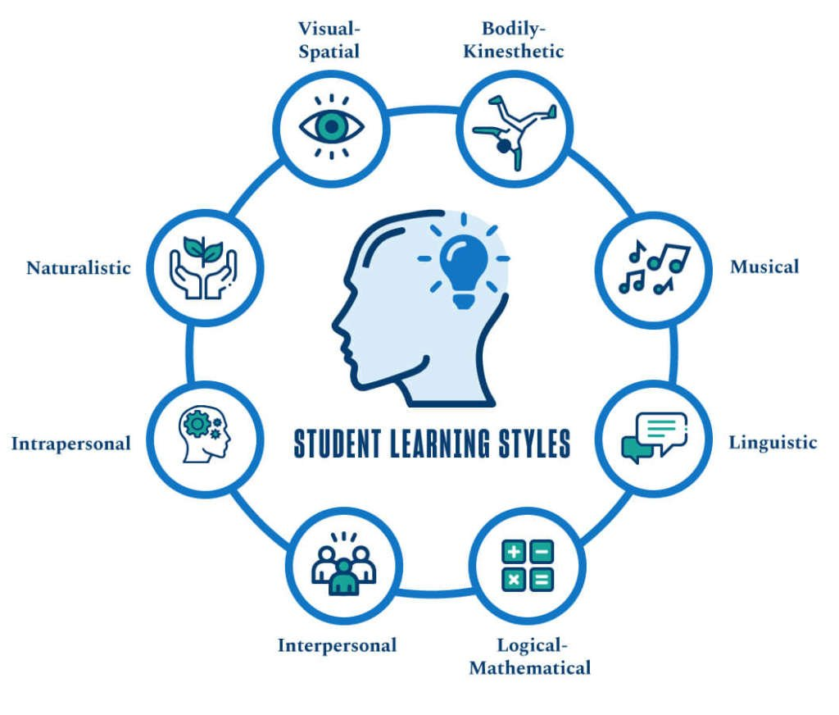
Learning & Teaching/Training Styles
Consider learning styles and teaching styles
There are lots! Consider being the:
Facilitator
The facilitator’s job is to support everyone to do their best thinking.
To do this, the facilitator encourages full participation, promotes mutual understanding and cultivates shared responsibility.
By supporting everyone to do their best thinking, a facilitator enables group members to search for inclusive solutions and build sustainable agreements.
University of San Diego
Kaner & Berger, 1996

Slide 9
Training provider (you), Audience & Stakeholders for training
Stakeholders
Interest, influence,
impact, involvement
Audience
Training
participants
Training provider

Slide 10
Stakeholders
Stakeholders
Interest, influence,
impact, involvement
Audience
Training
participants
Training provider

Slide 11
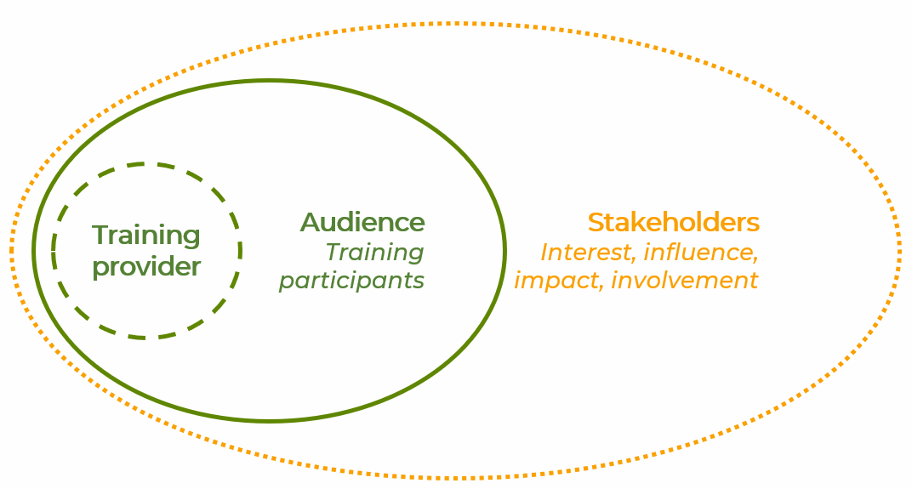
Stakeholder Analysis
Who are your stakeholders? Some initial questions
Who is/should be involved in making the training happen (approval, organising, execution, attendance, etc.)
What & how do they contribute?
What interests do the stakeholders have in the training?
What influence can or do the stakeholders have on the training?
How may stakeholders be affected or impacted by the training?
Which stakeholders are essential to involve?
At which stage do the stakeholders need to be involved?
Several ways to identify stakeholders
Several ways to think about their involvement: interest, influence, impact, roles, timing, etc.

Slide 12
Stakeholder Analysis example: Interest/Influence
Stakeholder mapping for citizen science training implementation
Interest
High
Intervention Area: Research
Interest
  Who is interested?
  Who could you interest?
  Who should be interested?
Influence
  Who influences whether your training will happen or not?
  Who is influenced by your training?
  Characteristics of stakeholders
External collaborators
Characteristics
……
……
ECRs
Characteristics
……
……
Dean
Characteristics
……
……
Researchers
Characteristics
……
……
Influence
Low
Research Library Staff
Characteristics
……
……
High
Funding Officers
Characteristics
……
……
Heads of Department
Characteristics
……
……
Low
Place your stakeholders according to their level of interest and influence

Slide 13
Stakeholder Analysis example: Timing/Stakeholders
Stakeholder mapping for citizen science training implementation
Intervention Area: Research
Stakeholders – any change agents?
Place your stakeholders according to when you need to involve them
External collaborators
Characteristics
External collaborators
Characteristics
Research Library Staff
Characteristics
Dean
Characteristics
Funding Officers
Characteristics
Heads of Department
Characteristics
Researchers
Characteristics
ECRs
Characteristics
Timing
Planning – Design – Coordination – Outreach – Execution – Evaluation – Follow-up

Slide 14
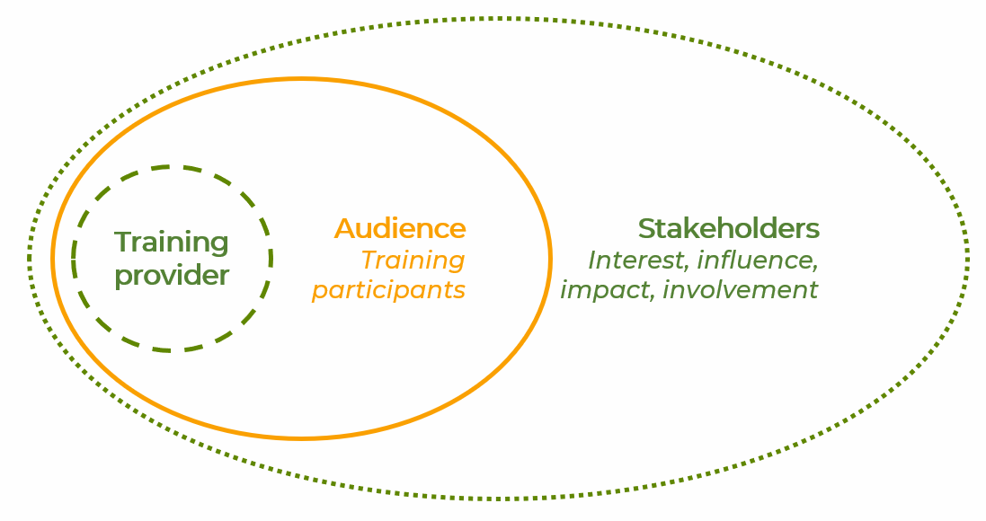
Stakeholder Analysis example: Audience
Stakeholder mapping for citizen science training implementation
Your training audience – a particular subset of stakeholders
Audience
External collaborators
Characteristics
External collaborators
Characteristics
Research Library Staff
Characteristics
Dean
Characteristics
Funding Officers
Characteristics
Heads of Department
Characteristics
Researchers
Characteristics
ECRs
Characteristics
Timing
Planning – Design – Coordination – Outreach – Execution – Evaluation – Follow-up

Slide 15




Training Audience / Participants
Map your target audience: characteristics
What are their biases?
What frustrates / motivates them?
What do they want to change?
-----------
-----------
Gain
What does your target audience want to achieve?
What are their needs/demands?
How do they measure success?
Pain
What are the fears,
frustrations, obstacles, challenges
of your target audience?
What influences them?
-----------
Who gives them challenges?
-----------
How do they access knowledge?
Which media/comms channels do they use?
-----------
Where do
they work?
-----------
How do they experience that they’re appreciated?
Think & Feel
General Data
Role | Gender
Hear
See
Say & Do
What do they talk about with their colleagues?
What does their environment say & do?
What kind of attitude do they have?
-----------
-----------
Adapted from Xplane.com

Slide 16
Stakeholder analysis
Training module TTT 1.1.2:
Interactive session

Slide 17
Interactive session: Conducting a stakeholder analysis and audience mapping
Program | Task
Group discussion | Participants conduct a stakeholder analysis (Interest/Influence and/or Timeline) in relation to a particular training opportunity and create an overview on a flip-chart (or Miro board). They are encouraged to share their training opportunity and identified relevant stakeholder groups.
From stakeholders to audience | Each participant or group identifies the target audience for their training opportunity.
Target audience characteristics | Participants discuss their audience’s characteristics using the target audience mapping framework (Empathy Mapping) from Xplane, including identifying their audience’s Gain and Pain, what they Say & Do, See, Hear, and Think & Feel. Insights are plotted on another flip-chart (or Miro board).
Presentation and feedback | Each group or individual presents their flip-charts, explaining their identified stakeholders and the characterization of their target audience. Presentations are followed by a feedback session, where peers and/or facilitators ask questions, provide constructive comments, alternative perspectives, and suggestions for improvement.
Conclusion and reflection | The session concludes with participants reflecting on their learning experience. They consider how the stakeholder analysis and audience mapping has influenced their understanding of how to develop and conduct their future training sessions.

Slide 18
Training Design
Training module TTT 1.2

Slide 19
Training design using the Logic Model framework
Training module TTT 1.2.1

Slide 20
Training Design
How to customize and implement training modules
Identifying and describing your stakeholders and intended audiences
Done (previous module)
Defining your resources
Participants and trainers, staff time, capacity and capability, budget, facilities, materials, resources, partnerships and more that are available
Planning activities
Processes, tools, events, technology, and actions that are part of running the training
Anticipating results
Outputs: Direct products of activities, i.e., what participants learn
Outcomes: Changes in participants’ behaviour, knowledge, skills, status, functions
Impact: Important and relevant changes occuring in organizations or communities

Slide 21
The Logic Model (Theory of Change)
Resources: What do we need? | Activities: What do we do? | Outputs: What happens immediately? | Outcomes: What are my goals – short- and long-term? | Impacts: What may happen ultimately?

Slide 22
The Logic Model
Resources: What do we need? | Activities: What do we do? | Outputs: What happens immediately? | Outcomes: What are my goals – short- and long-term? | Impacts: What may happen ultimately?
Types of resources needed | Types of activities and stakeholders | Direct products of activities | Behavioural and social change | Changes in assumptions and contextual factors
Specific resources available | Specific activities planned | What the participants specifically produce | Benefits to participants | Organizational change
Staff capacity, money, facilities, materials, partnerships | Trainings, tasks, group work, tool use, actions, processes | Cognitive, attitudinal, and social capacities or connections | New forms of motivations, social action, practices, or communities | New values, policies, strategic aims, attitudes

Slide 23
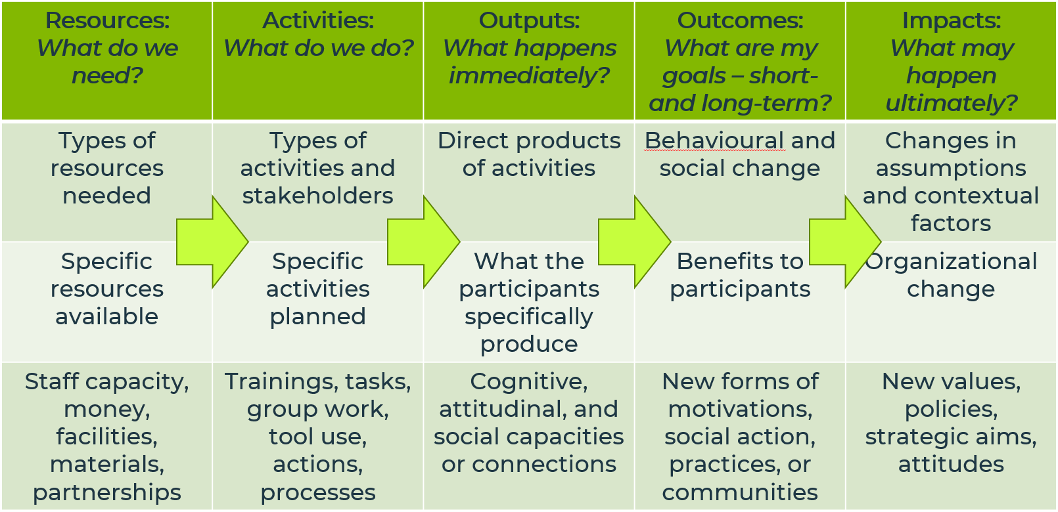
The Logic Model
Customize the Logic Model
For each of the 5 steps, carefully consider all aspects and note them down. Sometimes it is easier to work backwards, starting with considering the Impacts, then Outcomes, and so forth, to ensure your ultimate goal is reached
Then consider the arrows in the diagramme: how to get from one step to the next? These arrows may intertwine and one aspect of one step may lead to one or more aspects in the next step
Finally consider how you will evaluate the aspects in each step and the arrows leading to the next steps

Slide 24
Design your own training
Training module TTT 1.2.2:
Interactive session

Slide 25
Interactive session: Design your own training
Program | Task
Training focus | Participants consider which TIME4CS training modules to work with for the training they are designing (or they may decide to design their own training modules)
Applying the Logic Model | Each participant or group applies the Logic Model to their training opportunity, considering: Impact: What should be the ultimate impacts (on the organization or participants)? What basic assumptions and values may change – and how? Who (other than participants) will be impacted by the training? Outcomes: What are the intended benefits to participants? In what way (if any) will they have received an incentive to change their behaviour, attitude, thinking, or practice? Outputs: What outputs will the participants produce during the training? What will they have gained (learned) immediately upon completing the training? Will they have expanded their social network? How? Activities: Who are the participants? What will they do during the training? What kind of activities, tools or exercises will be useful? Which processes will you facilitate? Resources: What do you need for this training? What is already available? What could be made available? How? Types of resources needed, specific resources available – and wanted Links (arrows): How do you facilitate the effect on the next step, ensuring progress?
Presentation and feedback | Each group or individual presents their flip-charts, explaining the different aspects in each step of their particular training opportunity. Presentations are followed by a feedback session, where peers and/or facilitators ask questions, provide constructive comments, alternative perspectives, and suggestions for improvement.
Conclusion and reflection | The session concludes with participants reflecting on their learning experience. They consider how using the Logic Model to develop training sessions may facilitate training implementation and ensure training goals are met.

Slide 26
Challenges and solutions to implementing and embedding citizen science training
Training module TTT 1.3

Slide 27
SWOT (Strengths, Weaknesses, Opportunities, Threats) analysis of implementation of training programs
Training module TTT 1.3.1

Slide 28
Challenges & Possible solutions
Challenges
Lack of interest/time from researchers
Resistance to change
From ESF

Slide 29
Challenges & Possible solutions
Challenges
Lack of interest/time from researchers
Resistance to change
Possible solutions
Use effective and clear messaging about events and involvement
Address researchers individually, stressing what they can contribute and what they can gain
Importance of framing training sessions /events
→ always address the best in people
From ESF

Slide 30
SWOT for implementing training (before/during training)
Challenges
Opportunities/solutions
Threats
Use effective and clear messaging about events and involvement
Address researchers individually, stressing what they can contribute and what they can gain
Lack of interest/time from researchers
Importance of framing training sessions /events
→ always address the best in people
Resistance to change

Slide 31
SWOT for implementing training (before/during training)
Strengths
Central entity organizing capacity building for staff
Management backing
Weaknesses
No easy way to reach staff / target audience groups
No management backing
Challenges
Opportunities/solutions
Threats
Use effective and clear messaging about events and involvement
Address researchers individually, stressing what they can contribute and what they can gain
Lack of interest/time from researchers
Importance of framing training sessions /events
→ always address the best in people
Resistance to change

Slide 32
Identifying challenges and solutions to implementing training
Training module TTT 1.3.2:
Interactive session

Slide 33
Interactive session: Identifying challenges and solutions to implementing training
Program | Task
Group discussion: SWOT for training implementation | Participants discuss the possible Strengths, Weaknesses, Opportunities and Threats (SWOT) to their training implementation (before and during training) and note their findings on a flip-chart (or Miro board – template on next slide).
Group discussion: SWOT for embedding training | Participants discuss the possible Strengths, Weaknesses, Opportunities and Threats (SWOT) to embedding their training (after the training event), considering: Will learnings be used? Why/why not? What is likely to happen after the training event? What could follow-ups look like / which follow-ups will be needed? Participants note their findings on a flip-chart (or Miro board).
Presentation and feedback | Participants or groups present their findings in a two-minute pitch, outlining main factors potentially influencing their implementation or embedding of the planned training. Presentations are followed by a feedback session, where peers and/or facilitators provide constructive comments, alternative perspectives, and possible new inputs.
Conclusion and reflection | The session concludes with participants reflecting on their learning experience. They consider how the SWOT could help them mitigate challenges (Weaknesses and Threats) through use of revealed solutions (Strengths and Opportunities).

Slide 34
SWOT for implementing training (before/during training)
Strengths
Weaknesses
Solutions
Challenges
Opportunities
Threats

Slide 35
SWOT for embedding training (after conducting training)
Strengths
Weaknesses
Solutions
Challenges
Opportunities
Threats

